Slide 1


Tutor Adda
Presented by
1) Dilip Kumar
2) Karishma Patil
3) Rahul Sharma
4) Mandar Wajage
5)Sanchet Chimankar
6)Chandrahar Shinde

Slide 2
The purpose of “Tutor Adda” app is to enroll student to particular course and assist teachers to manage their schedule. Student can Login on the website and able to Search the course according to it system will show the running batches. Tutors can launch new courses and system will show available time-slot based one teacher’s schedule and selected batch’s schedule. And finally teacher and students can see their respective schedule based on their selected courses Tutor’s Adda contains following core functions: 1) Landing page : It contains portal information with 3 login for admin, teacher, student. 2)Admin Dashboard 3)Teacher Dashboard 4)Student Dashboard Below usecase shows the flow of the project and all sub-features of dashboards

Slide 3
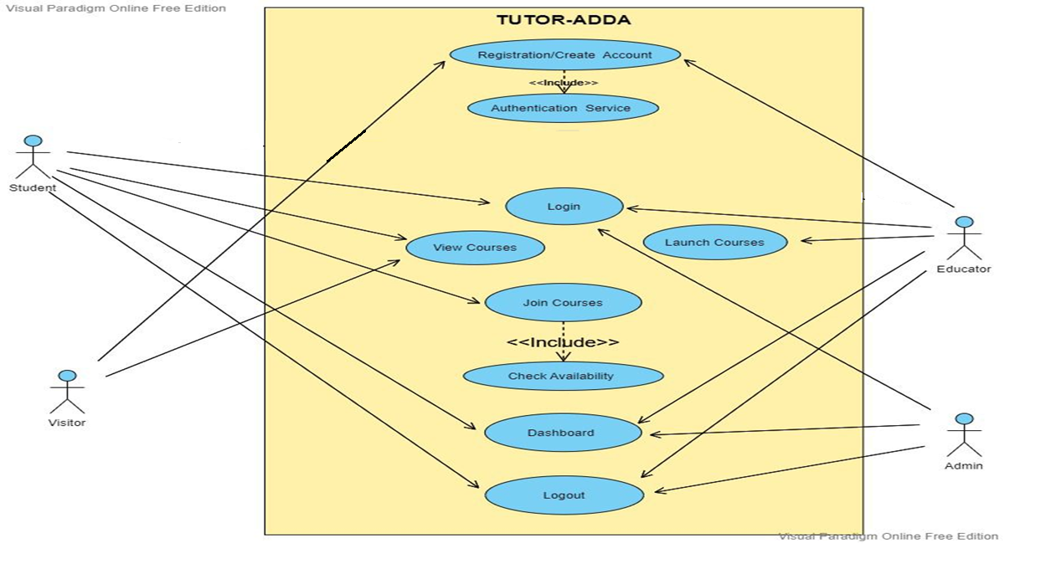
Use Case Diagram

Slide 4
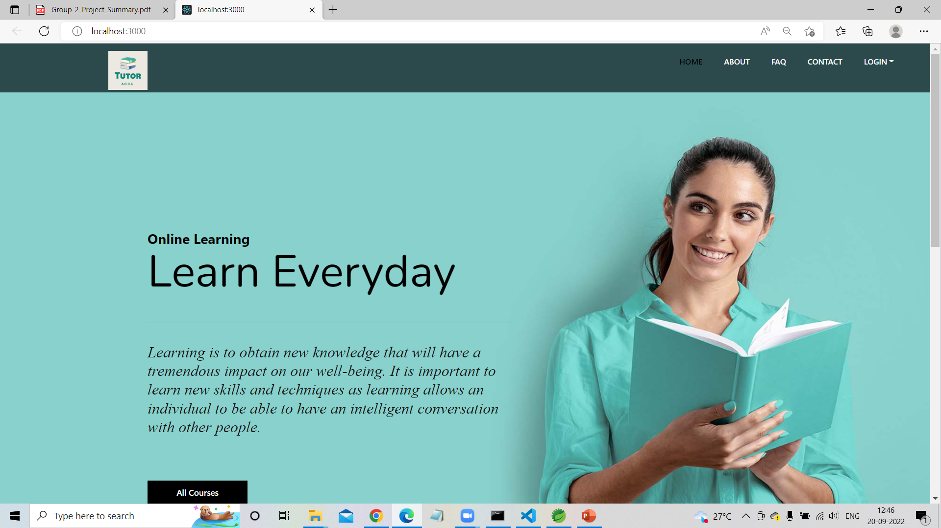
Website Landing Page

Slide 5
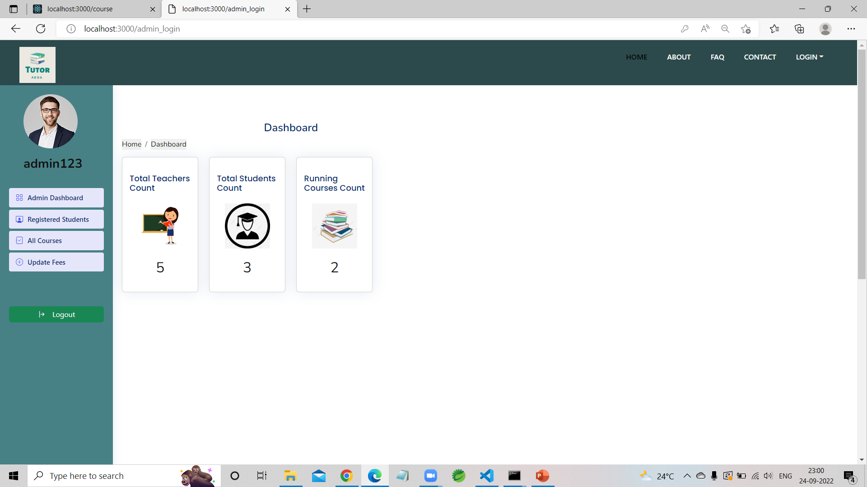
Admin Dashboard
Admin Module:
Admin module contains admin login/register page. After, login admin has dashboard containing options such like add/update Course. Admin Module has its own profile information with update option and logout option.

Slide 6
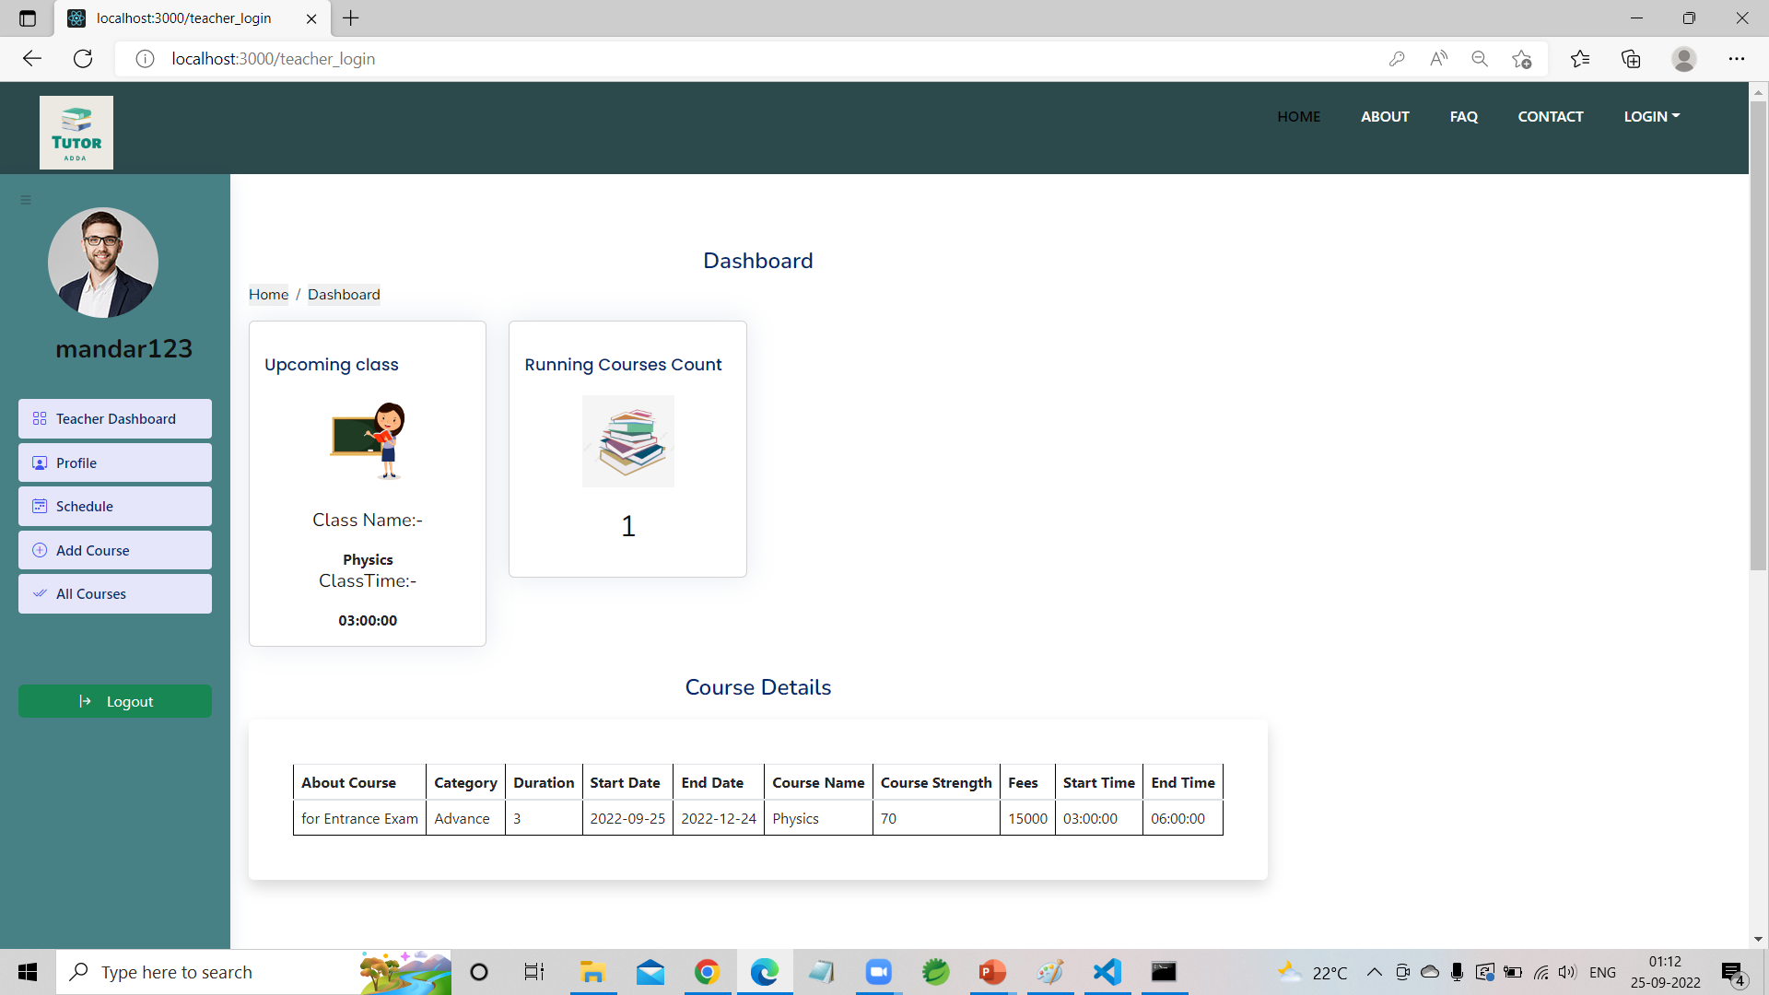
Teacher Dashboard
Teacher Module:
Teacher module contains login/register page. After, login Teacher has dashboard containing options such like add/update Courses, profile information of Student with update option and logout.

Slide 7
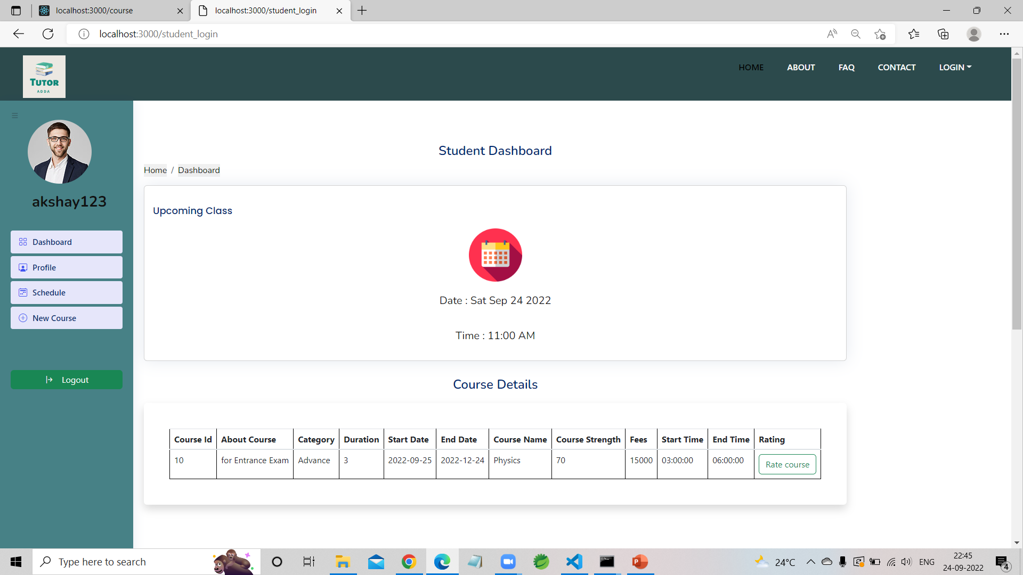
Student Dashboard
Student Module:
Student module contains student login/register page. After, login Student has dashboard containing options such like select the Course, profile information with update, view Course with choose the course option, feedback, logout.

Slide 8
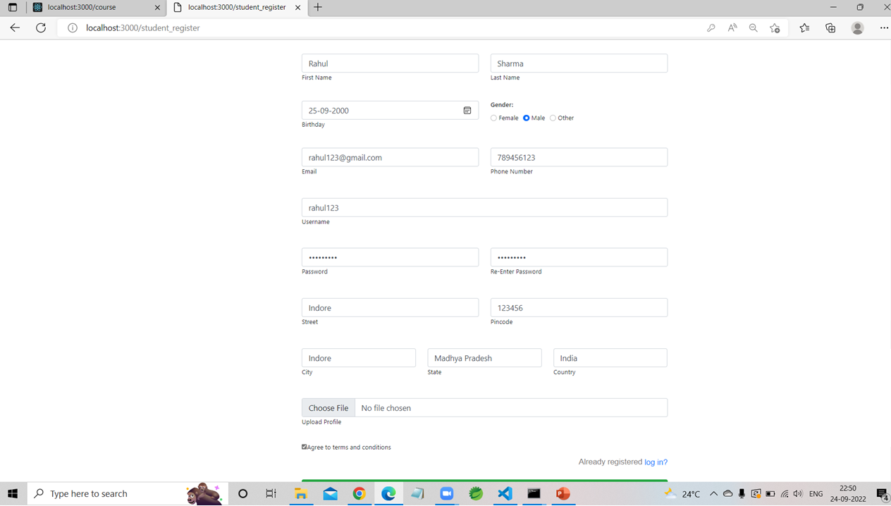
Student Registration

Slide 9
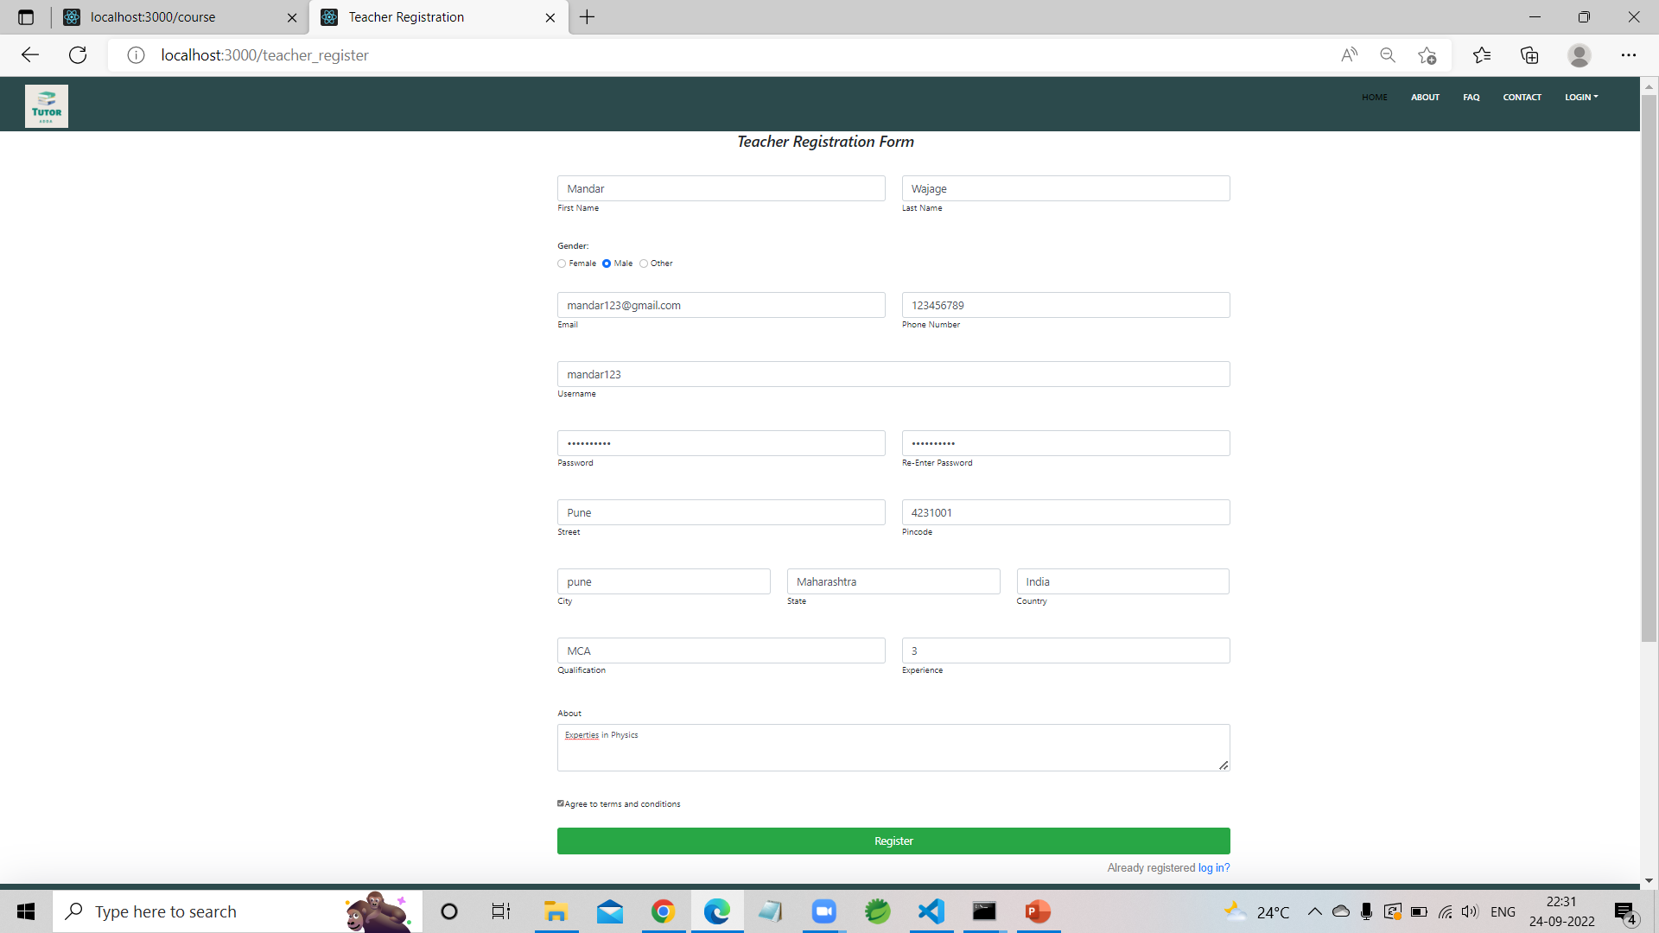


Teacher Registration

Slide 10
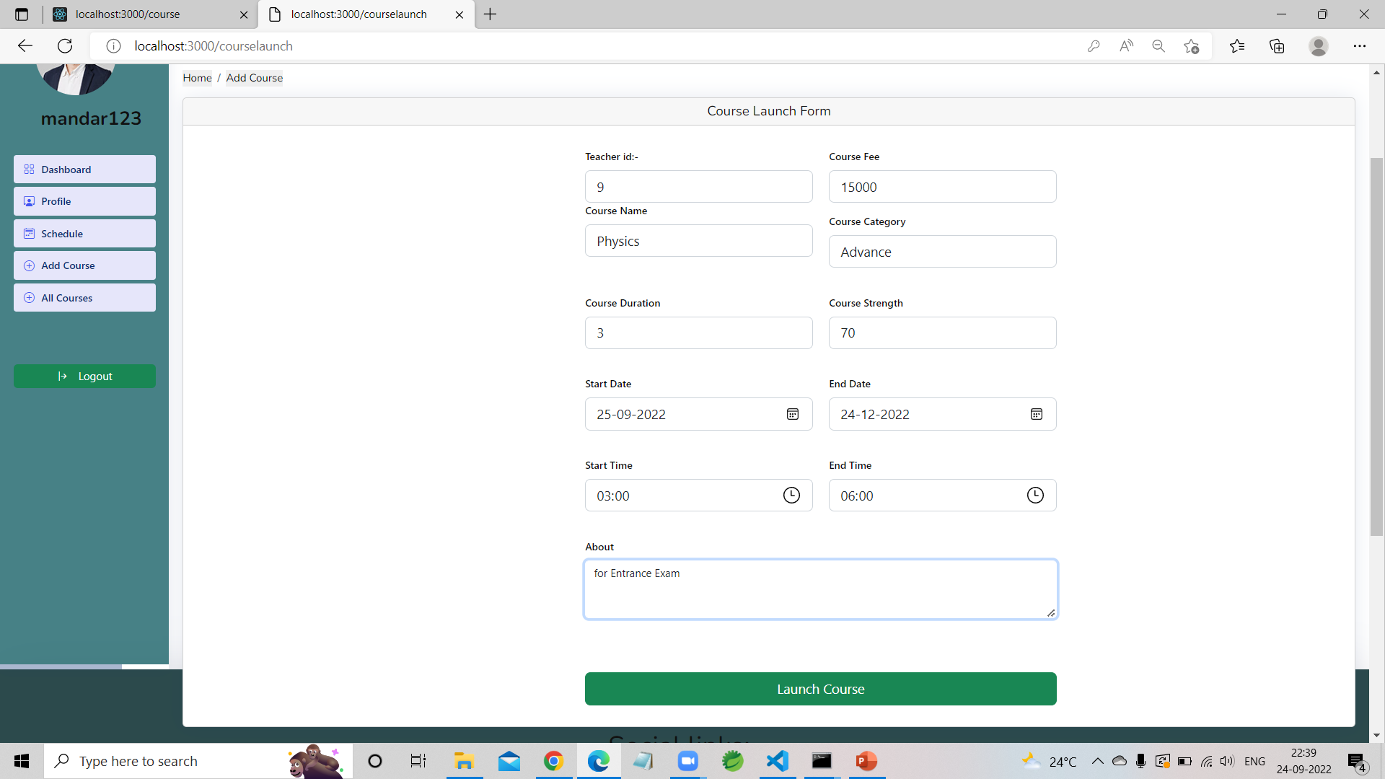
Course Launching Page

Slide 11
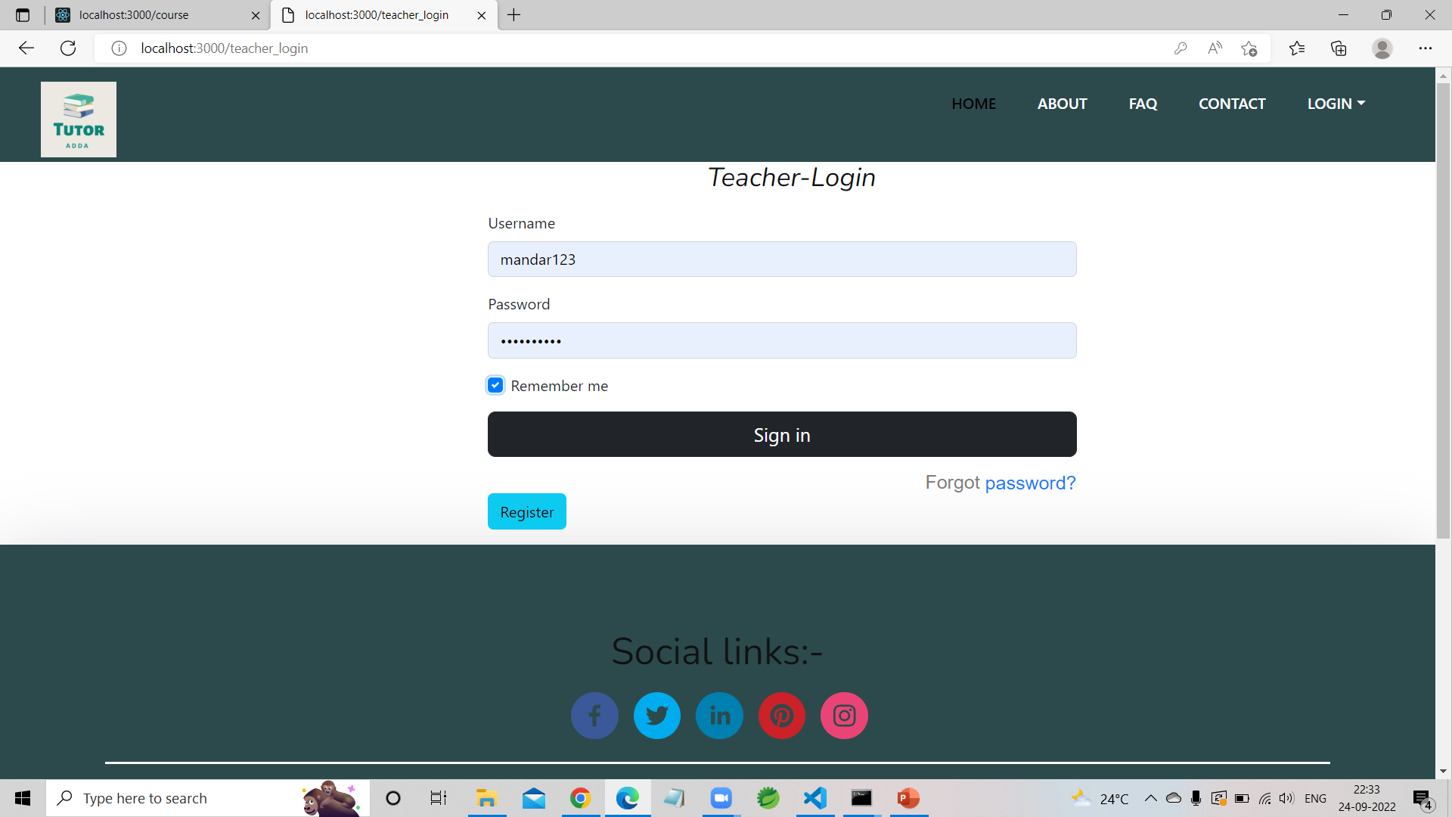
Teacher Login

Slide 12
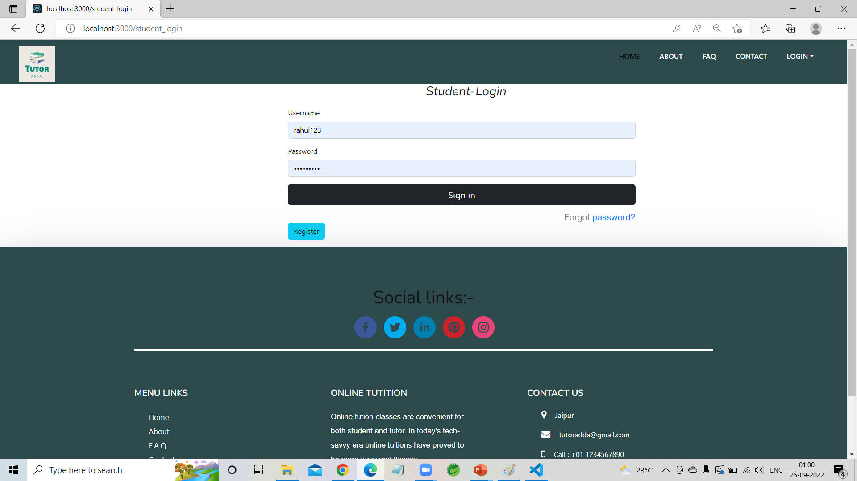
Student Login

Slide 13
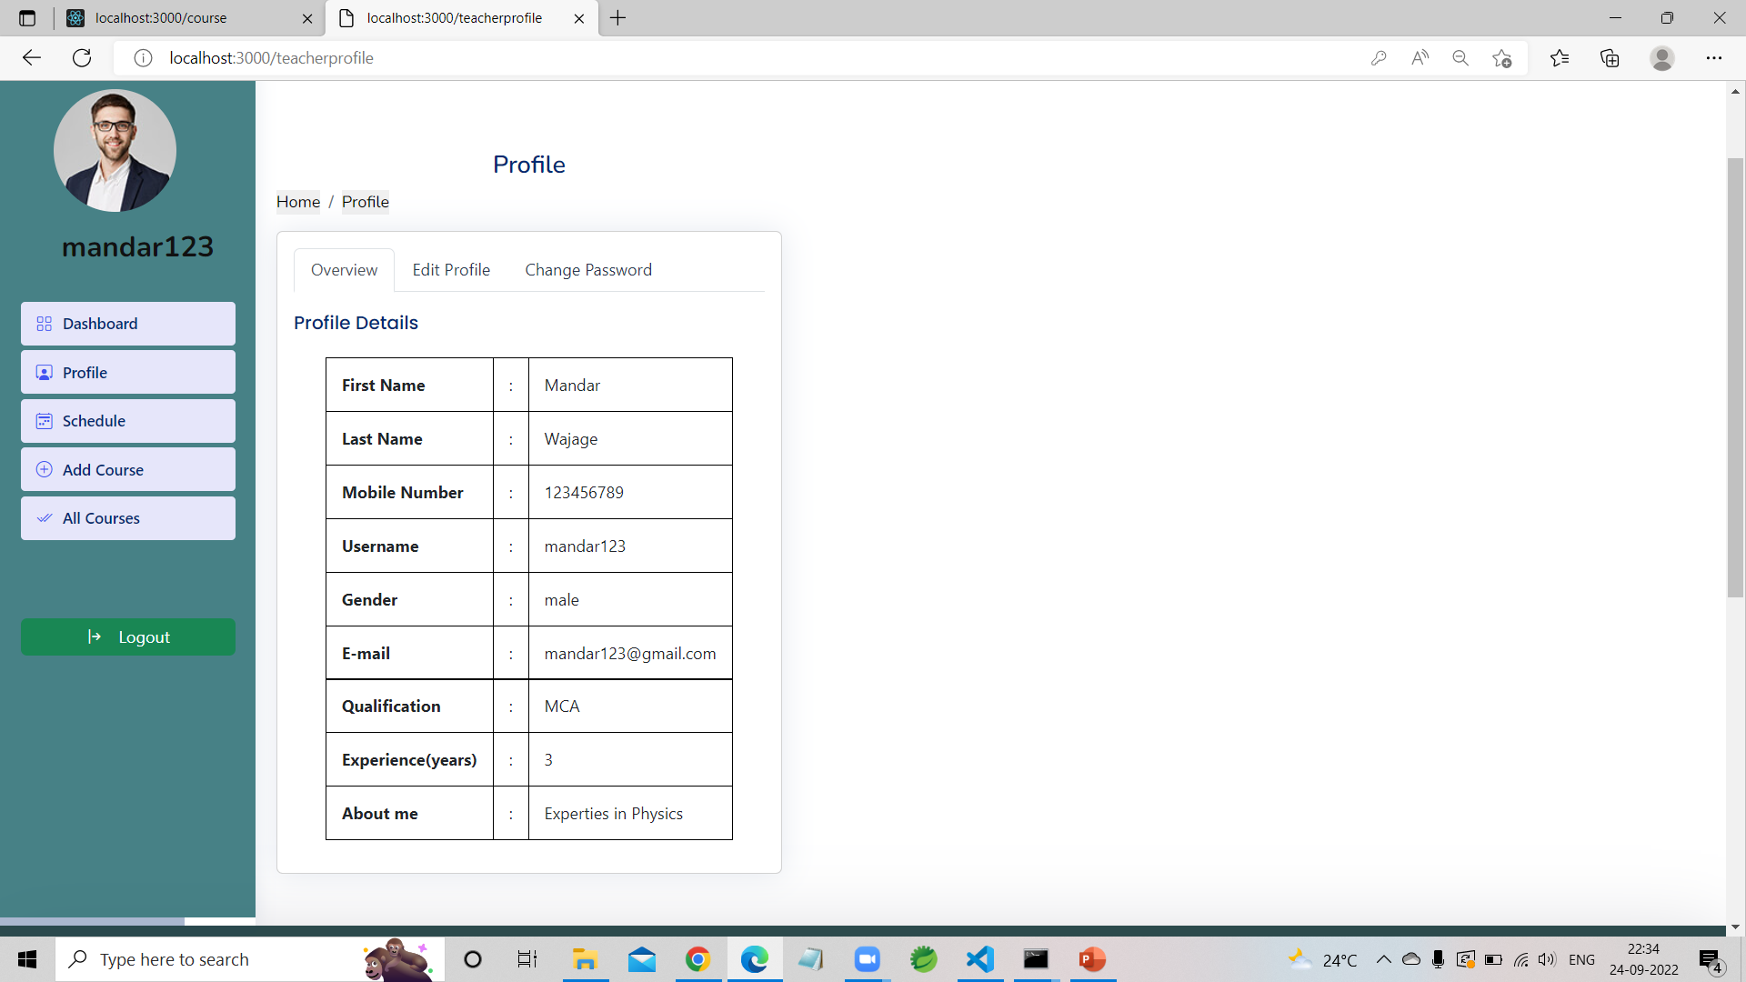
Teacher Profile

Slide 14
Course Launch Form

Slide 15
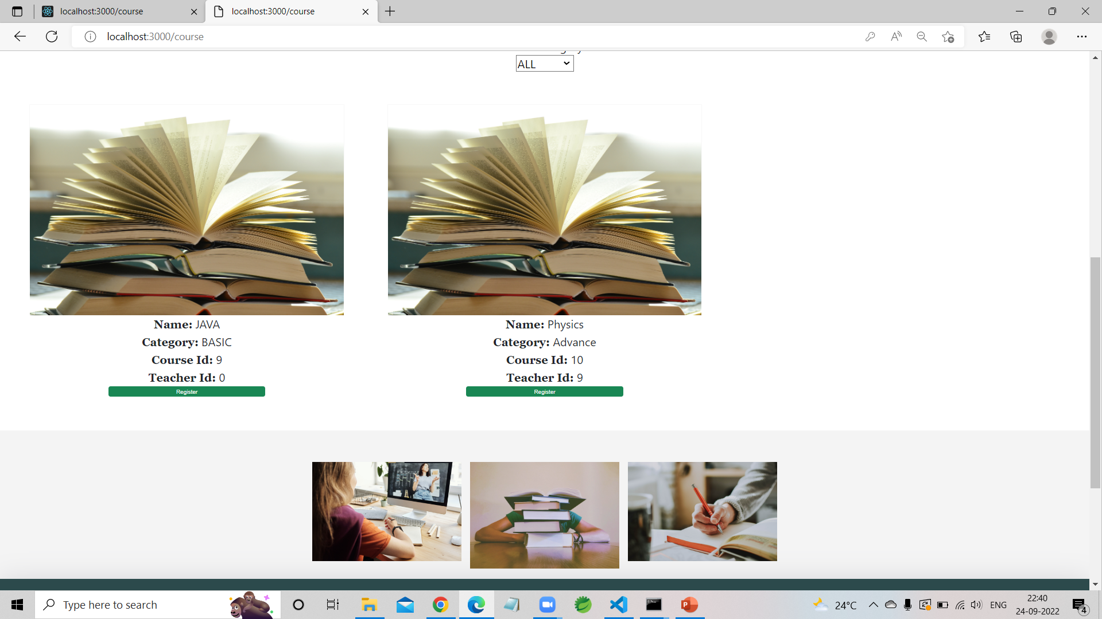

Courses

Slide 16
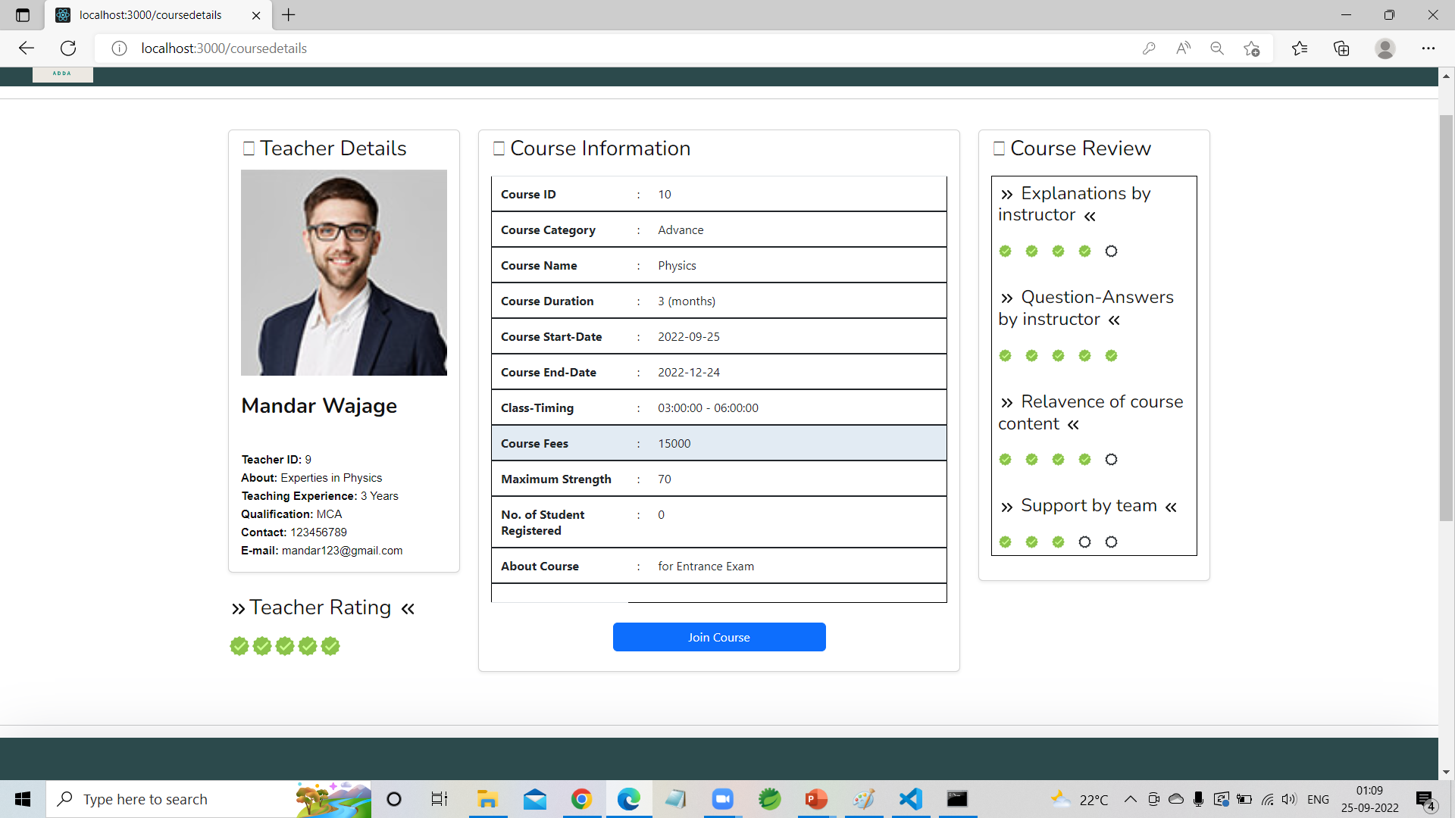
Teacher Details with Course

Slide 17
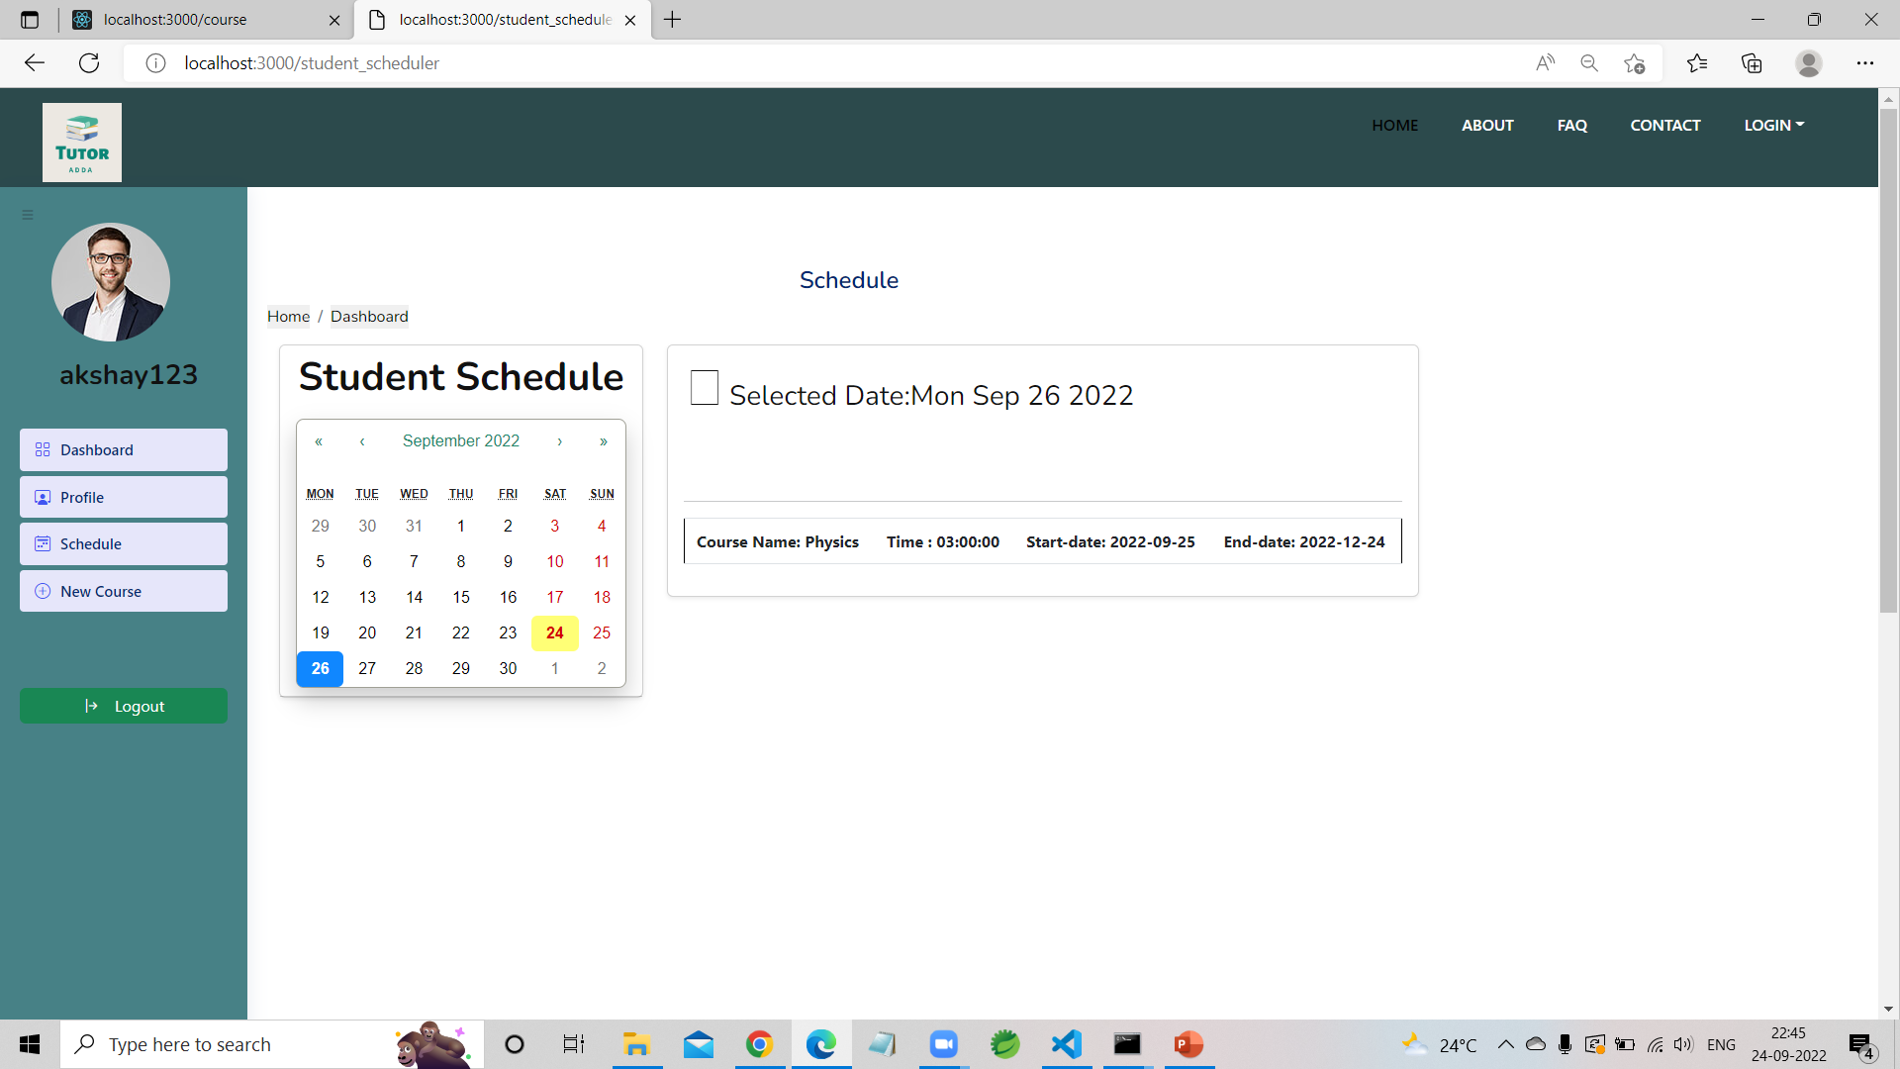
Student Schedule

Slide 18
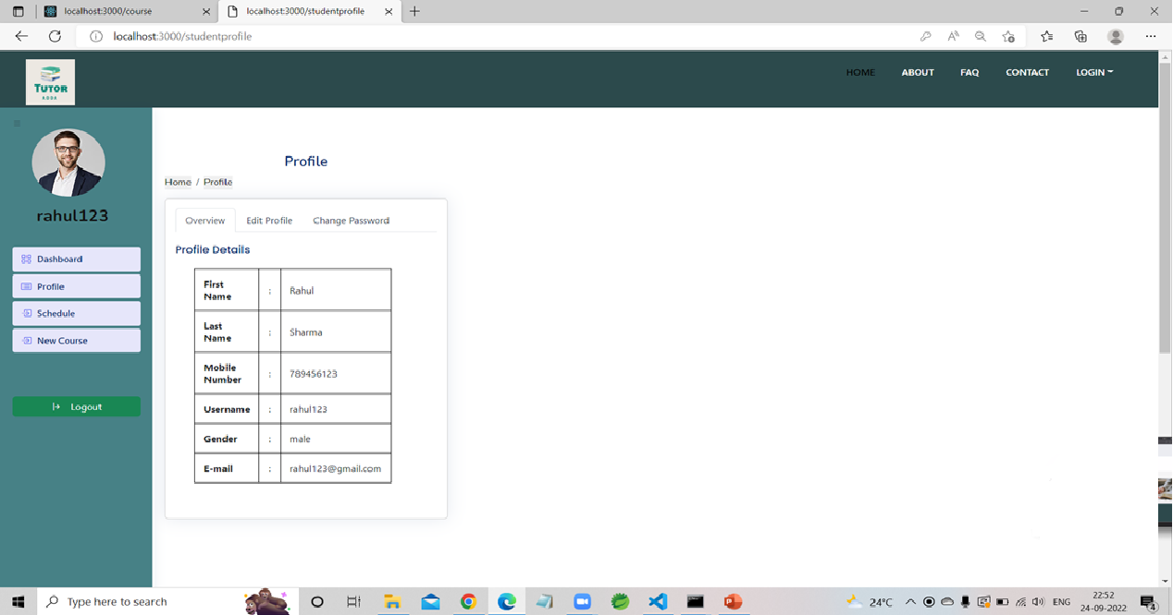
Student Profile

Slide 19


Slide 20
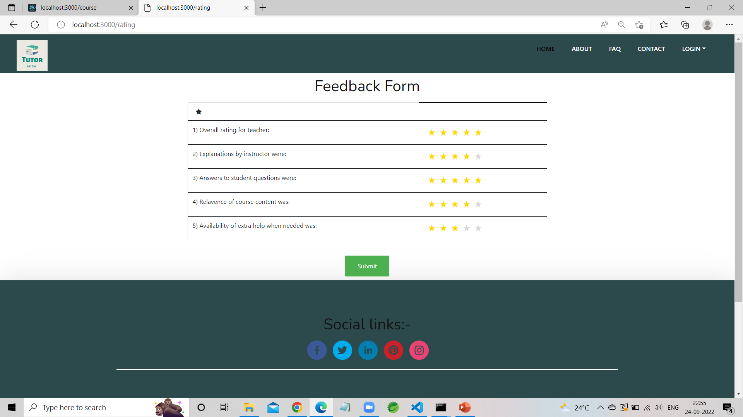
Feedback Form

Slide 21
Thank You

